Slide 1
Chapter 3
Feasibility Analysis
Bruce R. Barringer
R. Duane Ireland
3-<number>

Slide 2
Chapter Objectives
1 of 3
Explain what a feasibility analysis is and why it’s important.
Discuss the proper time to complete a feasibility analysis when developing an entrepreneurial venture.
Describe the purpose of a product/service feasibility analysis and the two primary issues that a proposed business should consider in this area.
Explain a concept statement and its components.
Describe the purpose of a buying intentions survey and how it’s administered.
3-<number>

Slide 3
Chapter Objectives
2 of 3
Explain the importance of library, Internet, and gumshoe research.
Describe the purpose of industry/market feasibility analysis and the two primary issues to consider in this area.
Discuss the characteristics of an attractive industry.
Describe the purpose of organizational feasibility analysis and list the two primary issues to consider in this area.
3-<number>

Slide 4
Chapter Objectives
3 of 3
10. Explain the importance of financial feasibility analysis and list the most critical issues to consider in this area.
3-<number>

Slide 5
What Is Feasibility Analysis?
Feasibility analysis is the
process of determining whether
a business idea is viable.
It is the preliminary evaluation
of a business idea, conducted
for the purpose of determining
whether the idea is worth
pursuing.
Feasibility Analysis
3-<number>

Slide 6
When To Conduct a Feasibility Analysis
Timing of Feasibility Analysis
  The proper time to conduct a feasibility analysis is early in thinking through the prospects for a new business.
  The thought is to screen ideas before a lot of resources are spent on them.
Components of a Properly Conducted Feasibility Analysis
  A properly conducted feasibility analysis includes four separate components, as discussed in the following slides.
3-<number>

Slide 7
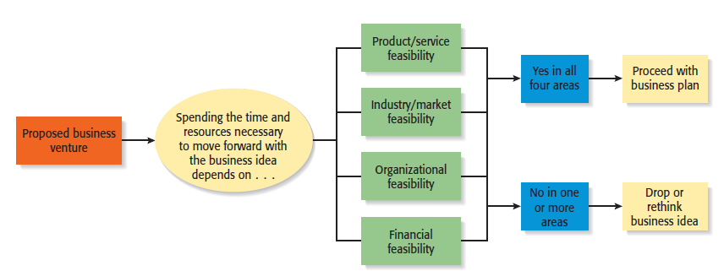
Feasibility Analysis
Role of feasibility analysis in developing business ideas.
3-<number>

Slide 8
Forms of Feasibility Analysis
Product/Service Feasibility
Industry/Target Market
Feasibility
Organizational Feasibility
Financial Feasibility
3-<number>

Slide 9
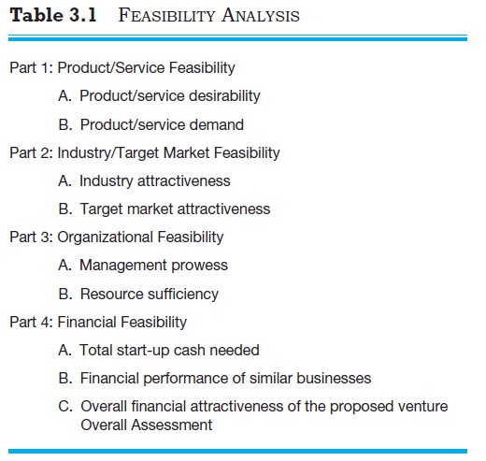
Outline for a Comprehensive Feasibility Analysis
3-<number>

Slide 10
Product/Service Feasibility Analysis
1 of 2
Purpose
Is an assessment of the overall
appeal of the product or service
being proposed.
Before a prospective firm rushes
a new product or service into
development, it should be sure
that the product or service is what
prospective customers want.
Product/Service Feasibility Analysis
3-<number>

Slide 11
Product/Service Feasibility Analysis
2 of 2
Components of product/service
feasibility analysis
Product/Service
Desirability
Product/Service
Demand
3-<number>

Slide 12
Product/Service Desirability
1 of 3
First, ask the following questions to determine the basic appeal of the product or service.
Does it make sense? Is it reasonable? Is it something consumers
will get excited about?
Does it take advantage of an environmental trend, solve a
problem, or take advantage of a gap in the marketplace?
Is this a good time to introduce the product or service to the
market?
Are there any flaws in the product or service’s basic design
or concept?
15-<number>

Slide 13
Product/Service Desirability
2 of 3
Second, Administer a Concept Test
  A concept statement should be developed.
  A concept statement is a one page description of a business, that is distributed to people who are asked to provide feedback on the potential of the business idea.
  The feedback will hopefully provide the entrepreneur
    A sense of the viability or the product or service idea.
    Suggestions for how the idea can be strengthened before proceeding further.
3-<number>

Slide 14
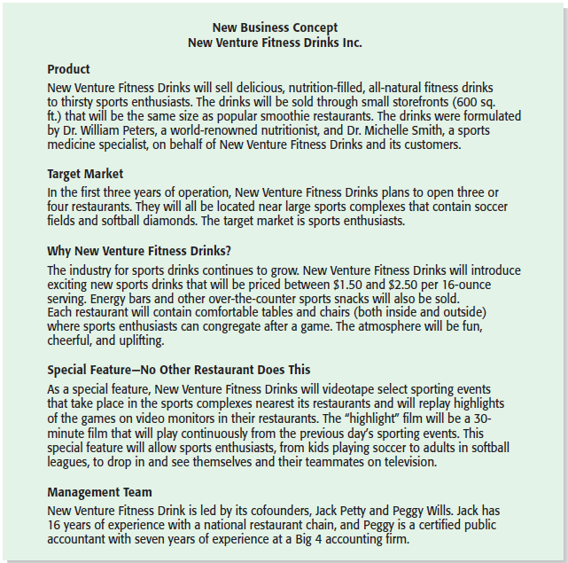
Product/Service Desirability
3 of 3
New Venture Fitness Drink’s Concept Statement
3-<number>

Slide 15
Product/Service Demand
1 of 6
Product/Service Demand
  Their are two steps to assessing product/service demand.
  Step 1: Administer a Buying Intentions Survey
  Step 2: Conduct library, Internet, and Gumshoe research
3-<number>

Slide 16
Product/Service Demand
2 of 6
Buying Intentions Survey
  Is an instrument that is used to gauge customer interest in a product or service.
  It consists of a concept statement or a similar description of a product or service with a short survey attached to gauge customer interest.
  Internet sites like SurveyMonkey make administering a buying intentions survey easy and affordable.
3-<number>

Slide 17
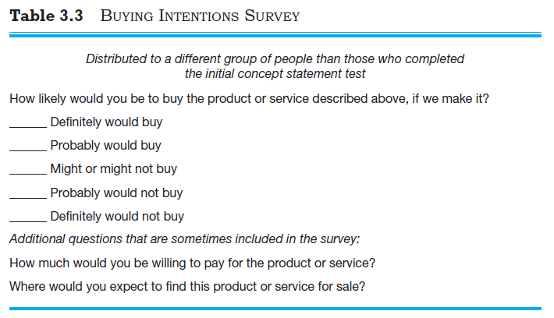
Product/Service Demand
3 of 6
3-<number>

Slide 18
Product/Service Demand
4 of 6
Library, Internet, and Gumshoe Research
  The second way to assess the demand for a product or service is by conducting library, Internet, and gumshoe research.
  Reference librarians can often point you towards resources to help you investigate a business idea, such as industry-specific trade journal and industry reports.
  Internet searches can often yield important information about the potentially viability of a product or service idea.
3-<number>

Slide 19
Product/Service Demand
5 of 6
Explanation
A gumshoe is a detective or an
investigator that around
for information or clues wherever
they can be found.
Be a gumshoe. Ask people
what they think about your product
or service idea. If your idea is to
sell educational toys, spend a week
volunteering at a day care center
and watch how children interact
with toys.
Gumshoe Research
3-<number>

Slide 20

Product/Service Demand
6 of 6
One of the most effective
things an entrepreneur
can do to conduct a
thorough product/service
feasibility analysis is to
hit the streets and talk to
potential customers.
This potential entrepreneur
is administering a survey
about a new product idea.
3-<number>

Slide 21
Industry/Target Market Feasibility Analysis
1 of 2
Purpose
Is an assessment of the overall
appeal of the industry and the
target market for the proposed
business.
An industry is a group of firms
producing a similar product or
service.
A firm’s target market is the
limited portion of the industry that it goes after or to which it wants to appeal.
Industry/Target Market Feasibility Analysis
3-<number>

Slide 22
Industry/Target Market Feasibility Analysis
2 of 2
Components of industry/target market
feasibility analysis
Industry Attractiveness
Target Market
Attractiveness
3-<number>

Slide 23
Industry Attractiveness
1 of 2
Industry Attractiveness
  Industries vary in terms of their overall attractiveness.
  In general, the most attractive industries have the characteristics depicted on the next slide.
  Other factors are also important—the degree to which environmental and business trends are moving in favor rather than against the industry are important for the industry’s long-term health. E.g Are changing economic and societal trends helping or hurting industry?
3-<number>

Slide 24
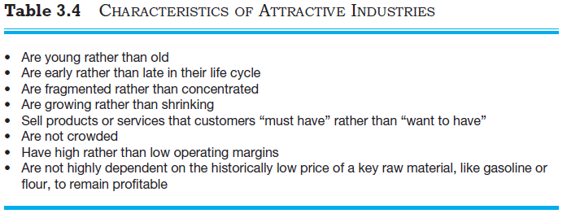
Industry Attractiveness
2 of 2
3-<number>

Slide 25
Target Market Attractiveness
Target Market Attractiveness
  The challenge in identifying an attractive target market is to find a market that’s large enough for the proposed business but is yet small enough to avoid attracting larger competitors.
  Assessing the attractiveness of a target market is tougher than an entire industry.
  Often, considerably ingenuity must be employed to finding information to assess the attractiveness of a specific target market.
3-<number>

Slide 26
Organizational Feasibility Analysis
1 of 2
Purpose
Is conducted to determine
whether a proposed business has
sufficient management expertise,
organizational competence, and
resources to successfully launch
a business.
Focuses on non-financial resources.
Organizational Feasibility Analysis
3-<number>

Slide 27
Organizational Feasibility Analysis
2 of 2
Components of organizational
feasibility analysis
Management Ability
Resource Sufficiency
3-<number>

Slide 28
Management Prowess
1 of 2
Management Ability:
  A firm should candidly evaluate the ability, of its management team to satisfy itself that management has the requisite passion and expertise to launch the venture.
  Two of the most important factors in this area are:
    The passion that the solo entrepreneur or the founding team has for the business idea.
    The extent to which sole entrepreneur or the founding team understands the markets in which the firm will participate.
3-<number>

Slide 29

Management Ability
2 of 2
An indication of passion
is the willingness of a
new venture team to
complete a comprehensive
feasibility analysis.
3-<number>

Slide 30
Resource Sufficiency
1 of 2
Resource Sufficiency
  The second area of organizational feasibility analysis is to determine whether an entrepreneur has sufficient resources to launch the proposed venture.
  To test resource sufficiency, a firm should list the 6 to 12 most critical nonfinancial resources that will be needed to move the business idea forward successfully.
    If critical resources are not available in certain areas, it may be impractical to proceed with the business idea.
3-<number>

Slide 31
Resource Sufficiency
2 of 2
Examples of nonfinancial resources that may be critical to the successful launch of a new business
Availability of affordable office or lab space.
Likelihood of local and state government support of the business.
Quality of the labor pool available.
Proximity to key suppliers and customers.
Willingness of high quality employees to join the firm.
Likelihood of establishing favorable strategic partnerships.
Proximity to similar firms for the purpose of sharing knowledge.
Possibility of obtaining intellectual property protection in key areas.
3-<number>

Slide 32
Financial Feasibility Analysis
1 of 2
Purpose
Is the final component of a
comprehensive feasibility analysis.
A preliminary financial assessment
is sufficient.
Financial Feasibility Analysis
3-<number>

Slide 33
Financial Feasibility Analysis
2 of 2
Components of financial
feasibility analysis
Total Start-Up Cash
Needed
Financial Performance of
Similar Businesses
Overall Financial
Attractiveness of the
Proposed Venture
3-<number>

Slide 34
Total Start-Up Cash Needed
Total Start-Up Cash Needed
  The first issue refers to the total cash needed to prepare the business to make its first sale.
  An actual budget should be prepared that lists all the anticipated capital purchases and operating expenses needed to get the business up and running.
  The point of this exercise is to determine if the proposed venture is realistic given the total start-up cash needed.
3-<number>

Slide 35
Financial Performance of Similar Businesses
Financial Performance of Similar Businesses
  Estimate the proposed start-up’s financial performance by comparing it to similar, already established businesses.
  There are several ways to doing this, all of which involve a little ethical detective work.
    First, there are many reports available, some for free and some that require a fee, offering detailed industry trend analysis and reports on thousands of individual firms.
    Second, simple observational research may be needed. For example, the owners of New Venture Fitness Drinks could estimate their sales by tracking the number of people who patronize similar restaurants and estimating the average amount each customer spends.
3-<number>

Slide 36
Overall Financial Attractiveness of the Proposed Venture
1 of 2
Overall Financial Attractiveness of the Proposed Venture
  A number of other financial factors are associated with evaluating financial attractiveness.
  In the feasibility analysis stage, the extent to which a business opportunity is positive relative to each factor is based on an estimate rather than actual performance.
  The table on the next slide lists the factors that pertain to the overall attractiveness of the financial feasibility of the business idea.
3-<number>

Slide 37
Overall Financial Attractiveness of the Proposed Venture
2 of 2
Financial Factors Associated With Promising Business Opportunities
Steady and rapid growth in sales during the first 5 to 7 years in a clearly
defined market niche.
High percentage of recurring revenue—meaning that once a firm wins a
client, the client will provide recurring sources of revenue.
Ability to forecast income and expenses with a reasonable degree of
certainty.
Internally generated funds to finance and sustain growth.
Availability of an exit opportunity for investors to convert equity to cash.
3-<number>

Slide 38
First Screen
First Screen
  Shown in Appendix 3.1, is a template for completing a feasibility analysis.
  It’s called “First Screen” because it’s a tool that can be used in the initial pass at determining the feasibility of a business idea.
  If a business idea cuts muster at this stage, the next step is to complete a business plan.
3-<number>

